Slide 1
Tools for this stuff
Tech Stack

Slide 2

What the Hey?
REST API Concepts
Designing the REST API
Securing the REST API
Swagger 2.0 / Open API
API Management

Slide 3
Design REST API
Create Our own REST API
Implement REST API
Error Handling for POST API
REST API Error Handling
API Caching
API Security
API FRAMEWORK

Slide 4
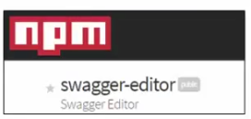





Tools, Platforms

Slide 5

Questions and Answers

